Slide 1
Chapter 23, 25,26
Software Engineering: A Practitioner’s Approach, Roger S. Pressman
Maintenance Measures

Slide 2
Software Measurement & Metrics
Measurement
Software measurement is concerned with deriving a numeric value or profile for an attribute of a software. i.e. direct value (LOC)
Used to draw conclusions about the quality of software, or assess the effectiveness of software processes, tools, and methods. e component, system, or process.
Metric
A software metric is a characteristic of a software system, system documentation, or development process that can be objectively measured. i.e. derived value (Defect Density)

Slide 3
Characteristics of Measurement Procedure
Measurement process can be characterized by five activities:
Formulation. The derivation of software measures and metrics appropriate for the representation of the software that is being considered.
Collection. The mechanism used to accumulate data required to derive the formulated metrics.
Analysis. The computation of metrics and the application of mathematical tools.
Interpretation. The evaluation of metrics resulting in insight into the quality of the representation.
Feedback. Recommendations derived from the interpretation of product metrics transmitted to the software team.

Slide 4
Types of Metrics
Product Metrics: Product metrics are used to evaluate the state of the product, tracing risks and undercover prospective problem areas. The ability of the team to control quality is evaluated. Examples include lines of code, cyclomatic complexity, code coverage, defect density, and code maintainability index.
Process Metrics: Process metrics pay particular attention to enhancing the long-term process of the team or organization. These metrics are used to optimize the development process and maintenance activities of software. Examples include effort variance, schedule variance, defect injection rate, and lead time.
Project Metrics: The project metrics describes the characteristic and execution of a project. Examples include effort estimation accuracy, schedule deviation, cost variance, and productivity.

Slide 5
Product Metrics
Most commonly used source of measures in the software system is the source code.
Some code based metrics are -
  LOC
  Function Point
  Cyclomatic Complexity
  Coupling
  Cohesion
  Maintainability Index

Slide 6
  LOC
One of the commonest ways of measuring the size of a program is by counting the number of lines of code.
Moller and Paulish define lines of code (LOC) as "the count of program lines of code excluding comment or blank lines".
The advantage of this measure is that it is easy to determine and also correlates strongly with other measures such as effort and error density.
There are no standards for LOC measurement and it is dependent on the programming language in question.
Also it is too simplistic and does not reflect cost or productivity. Despite these criticisms, this measure is still widely used.

Slide 7

  Cyclomatic Complexity
It is the difficulty of maintaining, changing and understanding programs.
Two of the most popular code complexity measures: McCabe's cyclomatic complexity and Halstead's difficulty measure
  McCabe's Cyclomatic Complexity:
  McCabe views a program as a directed graph in which lines of program statements are represented by nodes and the flow of control between the statements is represented by the edges. McCabe's cyclomatic complexity (also known as the cyclomatic number) is the number of 'linearly independent' paths through the program (or flow graph) and this value is computed using the formula:.

Slide 8
  Cyclomatic Complexity
  Advantages:
It helps to identify highly complex programs that may need to be modified in order to reduce complexity.
The cyclomatic number can be used as an estimate of the amount of time required to understand and modify a program.
The flow graph generated can be used to identify the possible test paths during testing.

Slide 9
  Cyclomatic Complexity
Disadvantages:
It takes no account of the complexity of the conditions in a program, for example multiple use of Boolean expressions, and over-use of flags.
In its original form, it failed to take account of the degree of nesting in a program. As such, two programs may have been considered to be equally complex based on cyclomatic number whereas in actual fact, one had a greater level of nesting than the other.

Slide 10
  Cyclomatic Complexity
  Halstead's Measures:
Halstead developed expressions for the overall program length, potential minimum volume for an algorithm, the actual volume (number of bits required to specify a program), the program level (a measure of software complexity), the language level (a constant for a given language), and other features such as development effort, development time, and even the projected number of faults in the software.
The measures for these attributes can be computed from four basic counts:

Slide 11
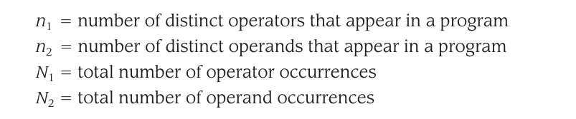
  Cyclomatic Complexity
An operand is a variable or constant.
An operator is an entity that can either change the value of an operand or the order in which it is changed.
Operators include arithmetic operators (for example, *, /, + and -), keywords (for example, PROCEDURE, WHILE, REPEAT and DO), logical operators (for example, greater than, equal to and less than), and delimiters.

Slide 12
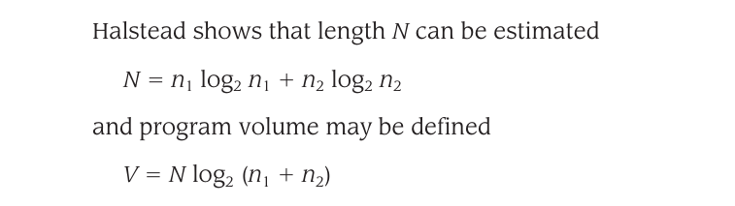

  Cyclomatic Complexity
  Halstead's Measures:
The four basic counts can also be used to compute other attributes such as programming time, number of bugs in a program and understandability.
Vocabulary, n = n1+n2
Length, N = N1+N2
Volume, V = N log n
Difficulty, D = (n1/2)(N2/n2)
Effort, E = V*D
Volume ratio

Slide 13
  Cyclomatic Complexity
Advantages:
Easy to calculate and do not require an in-depth analysis of programming features and control flow.
Can be applied to any language
Empirical evidence shows that these measures can be used as good predictors of programming effort and number of bugs

Slide 14
  Cyclomatic Complexity
Disadvantages:
Experiments which were used to test the measures were badly designed and statistically flawed
Counting rules involved in the design of the measures were not fully defined
Failure to consider declarations and input/output statements as a unique operator for each unique label
measures are code-based; it is assumed that 'software = programs. Measures fail to capture the contribution that this documentation makes to the programming effort or program understanding.

Slide 15
Coupling & Cohesion
Coupling Between Objects (CBO): Counts the number of other classes a specific class is coupled with. A high CBO implies tight coupling and reduced maintainability.
Lack of Cohesion in Methods (LCOM): Counts the number of methods in a class that do not share access to the same instance variables. A lower LCOM score (close to 0) is ideal, indicating highly cohesive methods that operate on the same data.

Slide 16

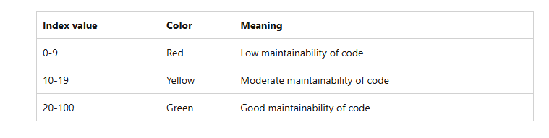
Maintainability Index

Slide 17
Function point (FP)
Functional Point Analysis (FPA) is a software measurement technique used to assess the size and complexity of a software system based on its functionality.
It involves categorizing the functions of the software, such as input screens, output reports, inquiries, files, and interfaces, and assigning weights to each based on their complexity.

Slide 18
Function Domain for FP
Function Domain | Meaning | Example (University Management System)
External Input (EI) | Data entered into the system by users | Student registration form
External Output (EO) | Reports or processed information generated by the system | Student transcript, fee receipt
External Inquiry (EQ) | User requests information without updating data | Search student information
Internal Logical File (ILF) | Data maintained by the system | Student database, Course database
External Interface File (EIF) | Data used by the system but maintained by another system | National ID database, Online payment gateway database

Slide 19

Function Point Formula
Functional Point is calculated with the following formula

Slide 20
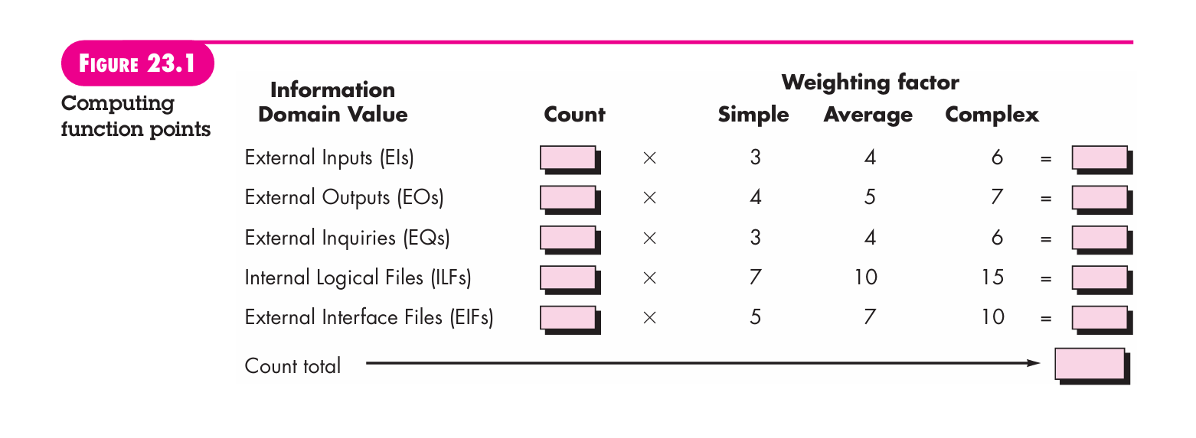
Unadjusted Function Point
UFP = Unadjusted Function Point
Multiply each individual function point to corresponding values in TABLE.

Slide 21
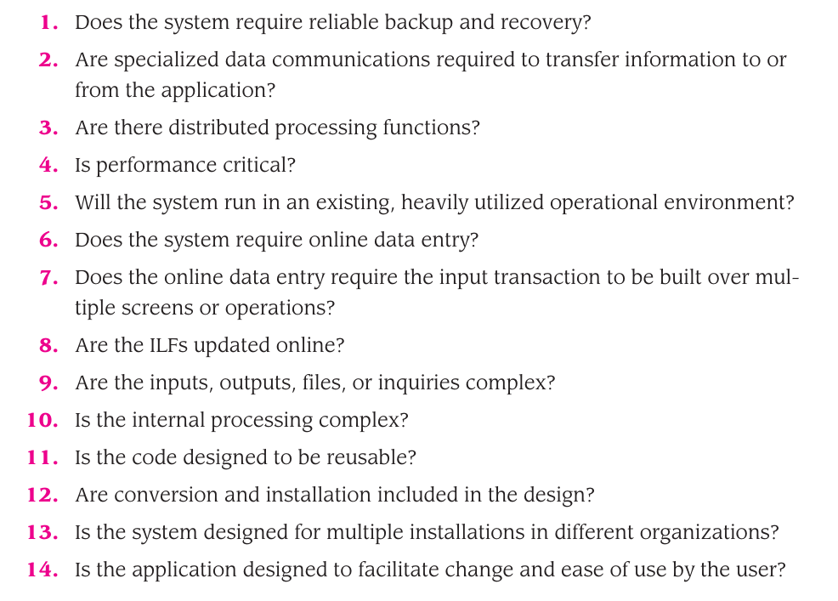
Value Adjustment Factor
VAF = [0.65 + 0.01 * ⅀(fi)]
⅀(fi) = sum of all 14 questions
Each of these questions is
answered using a scale that ranges from
0 (not important or applicable)
to 5 (absolutely essential).

Slide 22
Process Metrics
Defect Density
DRE
MTTR
MTBF
Test Coverage

Slide 23

Defect Density
Defect Density: Measures the concentration of bugs relative to software size.

Slide 24

DRE
Defect Removal Efficiency (DRE): Measures the effectiveness of the development and QA process.

Slide 25

MTTR
MTTR measures the average time it takes to resolve a system failure or incident and restore it to full operation.

Slide 26

MTBF
MTBF calculates the average operational uptime between consecutive failures, indicating overall system reliability.

Slide 27
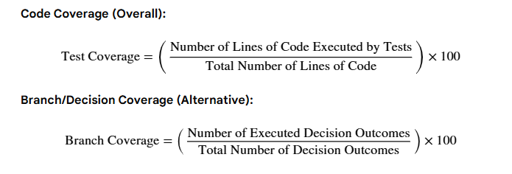
Test Coverage
Test Coverage assesses the comprehensiveness of your testing efforts. It measures the amount of source code executed by a specific testing suite and is represented by various specific coverage equations.

Slide 28
Project Metrics
Productivity
Cost Variance
Schedule Variance

Slide 29
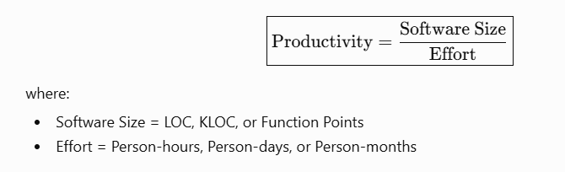
Productivity
Productivity measures how much software a team produces for a given amount of effort.

Slide 30
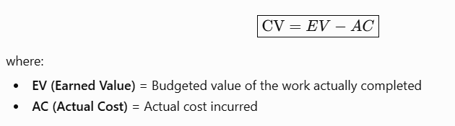
Cost Variance
Cost Variance measures whether the project is under budget or over budget.

Slide 31
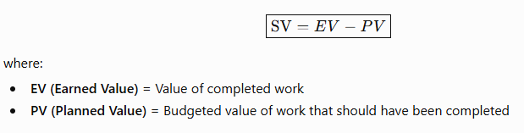
Schedule Variance
Schedule Variance measures whether the project is ahead of or behind schedule.

Slide 32
Maintenance Metrics
Software maturity index (SMI)
Change Requests
Outstanding Requests
Impact Analysis Time
Change Implementation Time
Maintenance Cost
Code Churn

Slide 33
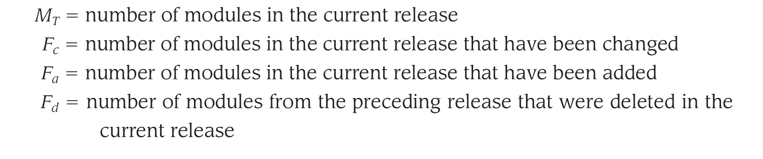
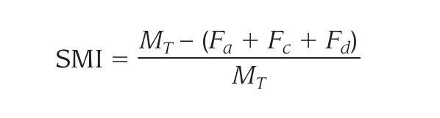
Software Maturity Index (SMI)
Software Maturity Index (SMI) that provides an indication of the stability of a software product (based on changes that occur for each release of the product). The following information is determined:

Slide 34
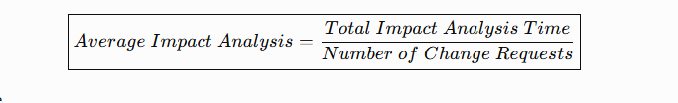
Impact Analysis Time
Measures the average time required to determine the impact of a change.

Slide 35
Change Implementation Time
Measures the average effort to implement changes.

Slide 36

Code Churn
Measures the amount of source code modified.

Slide 37
Change Requests

Slide 38
Software Estimation (Chapter 26)
“Estimation determines how much money, effort, resources, and time it will take to build a specific system or product.”
Supports planning and decision making.

Slide 39
Software Project Estimation
Past Data/Past Experience
Available Documents/Knowledge
Assumptions
Identified Risks

Slide 40
Steps to Project Estimation
Software size estimation
Software effort estimation
Software time estimation
Software cost estimation

Slide 41
Software size
KLOC
Number Of Function Point

Slide 42
Effort Estimation
Is calculated in Person-hour Or person-days or Person-month.
For effort estimation software size should be known.
software size can be converted into efforts by using some standard formulas. e,g cocomo-II

Slide 43
Cost Estimation
The cost of a maintenance project is the resources - personnel, machines, time and money - expended on effecting change.
One way of estimating the cost of a maintenance task is from historical data collected for a similar task.
A second way of estimating cost is through mathematical models. One of these was Boehm's COCOMO model adapted for maintenance.
According to Boehm, the cost of maintenance is affected by attributes of factors called cost drivers. Examples of cost drivers are database size, program complexity, use of modern programming practices and applications experience of the maintenance personnel.
A third measure of cost is time in person-months required to modify a program.

Slide 44
Empirical Estimation Technique
COCOMO-I: COCOMO stands for COnstructive COst MOdel, developed by Barry W. Boehm. It divides the software product into three categories of software: organic, semi-detached and embedded.
COCOMO-II : The motivations behind COCOMO II were object-oriented and component-based development, software reuse and commercial off-the-shelf integration, iterative and spiral development models, and modern tooling.
COCOMO II offers three sub-models, each suited to a different phase of a project's life, includes - Application Composition Model, Early Design Model , Post-Architecture Model

Slide 45
COCOMO-I
COCOMO (Constructive Cost Model) is a parametric software cost estimation model.
It takes one primary input, specifically the estimated size of a software project measured in Thousands of Lines of Code (KLOC),
Predicts three things -
  Total effort in person-months (PM),
  Development time in months
  The number of people needed.

Slide 46
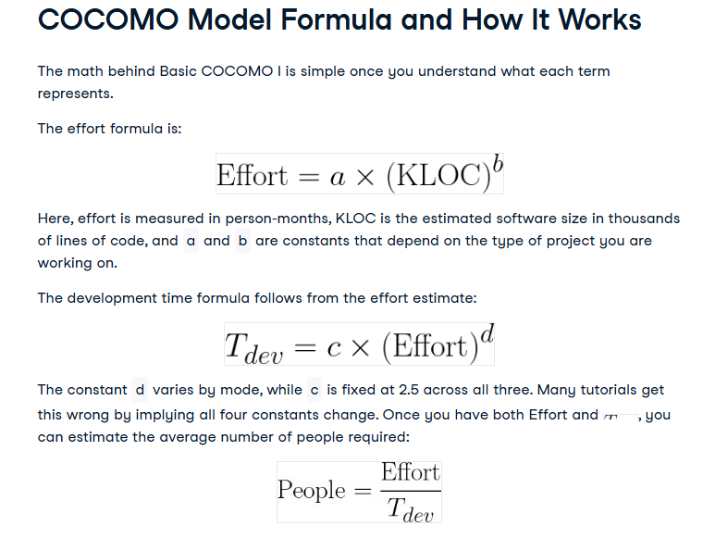

Slide 47
Project Mode
Organic mode
Organic mode covers small to medium projects where the team has solid experience with the application domain, requirements are relatively well understood, and there is no significant external pressure from hardware constraints or regulatory requirements. A payroll system, a data processing application, or an inventory management tool would typically fall here.
Semi-detached mode
Semi-detached mode sits in the middle. Teams in this category have mixed experience: some members know the domain well, others do not. The project has moderate complexity, and there may be some interaction with new hardware or external systems.
Embedded mode
Embedded mode applies to projects with tight operational constraints: strict hardware requirements, real-time processing demands, regulatory standards, or aerospace and defense requirements. The team may be large and technically skilled, but the complexity of integration, testing, and validation drives effort up sharply as project size increases.

Slide 48
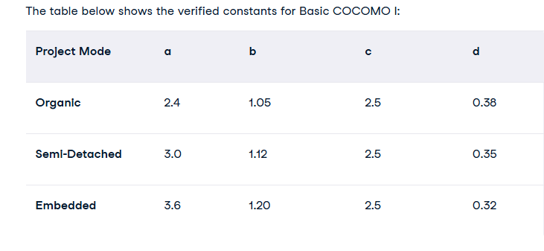

Slide 49
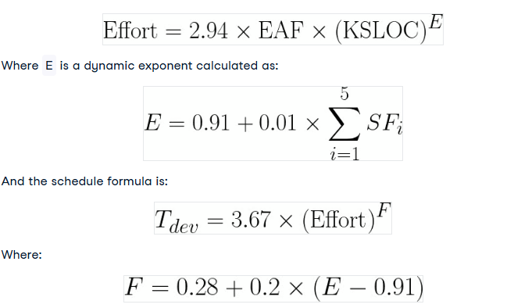
COCOMO - II

Slide 50
Five Scale Factors in COCOMO II
Precedentedness (PREC),
Development flexibility (FLEX),
Architecture and risk resolution (RESL),
Team cohesion (TEAM)
Process maturity (PMAT).
Each is rated on a scale from Very Low to Extra High, and their combined sum determines E in the effort formula. A higher sum means a less mature, less familiar, riskier project, which means a higher exponent and more effort.

Slide 51
Cost drivers
Cost drivers, by contrast, are multiplicative adjustments applied to the baseline effort.
COCOMO II has 17 cost drivers in the Post-Architecture model, compared to 15 in Intermediate COCOMO I.
The additions in COCOMO II include factors for required reusability (RUSE), documentation requirements (DOCU), platform volatility (PVOL), personnel continuity (PCON), application experience (APEX), platform experience (PLEX), language and tool experience (LTEX), and multisite development (SITE).

Slide 52
Advantages
The model's primary strength is transparency. Unlike proprietary estimation tools, COCOMO publishes all its equations, constants, and calibration methodology. Anyone can audit the inputs and verify the outputs. This makes it useful in government, defense, and aerospace procurement, where mathematical auditability is often a legal or contractual requirement.
The model can also be recalibrated. Organizations that collect their own project history data can adjust the constants to reflect their specific environment, team composition, and technology stack. This is important because the default constants come from datasets that are now decades old.
The three-level structure (Basic → Intermediate → Detailed) is another practical benefit. Early in a project, when little is known, you use Basic for a rough estimate. As the project matures and more is understood about the team and environment, you move to Intermediate or Detailed for more refined planning.

Slide 53
Limitations
The biggest limitation is COCOMO's dependency on KLOC. To use COCOMO, you need to estimate the size of a project in lines of code before you write any code. In the early stages of a project, exactly when estimation matters most, this is notoriously difficult to do accurately.
Even when KLOC can be estimated, the constants in COCOMO I come from 63 projects built under the waterfall model between 1968 and 1979. The constants in COCOMO II come from 161 projects from the 1990s. Neither dataset includes cloud-native systems, mobile applications, microservices architectures, or modern DevOps pipelines. Applying these constants directly to a modern project without local calibration produces unreliable estimates.

Slide 54
Estimation for Agile Development
Each user scenario (the equivalent of a mini use case created at the very start of a project by end users or other stakeholders) is considered separately for estimation purposes.
The scenario is decomposed into the set of software engineering tasks that will be required to develop it.
The effort required for each task is estimated separately. Note: Estimation can be based on historical data, an empirical model, or “experience.”
Alternatively, the “volume” of the scenario can be estimated in LOC, FP, or some other volume-oriented measure (e.g., use-case count).
Estimates for each task are summed to create an estimate for the scenario.
Alternatively, the volume estimate for the scenario is translated into effort using historical data.
The effort estimates for all scenarios that are to be implemented for a given software increment are summed to develop the effort estimate for the increment

Slide 55
Estimation for WebApp Projects
Consider the followings to adapt function points for WebApp estimation:
Inputs are each input screen or form (for example, CGI or Java), each maintenance screen, and if you use a tab notebook metaphor anywhere, each tab.
Outputs are each static Web page, each dynamic Web page script (for example, ASP, ISAPI, or other DHTML script), and each report (whether Web based or administrative in nature).
Tables are each logical table in the database plus, if you are using XML to store data in a file, each XML object (or collection of XML attributes).
Interfaces retain their definition as logical files (for example, unique record formats) into our out-of-the-system boundaries.
Queries are each externally published or use a message-oriented interface. A typical example is DCOM or COM external references

